Slide 1
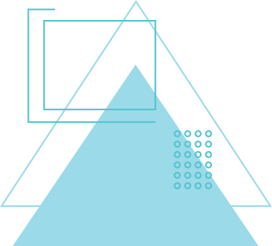
SIGN LANGUAGE RECOGNITION
HARSH GUPTA

Slide 2
INTRODUCTION
Sign Language is a visual language using hand gestures and facial expressions, widely used by deaf and hard-of-hearing individuals.
Hearing-impaired people face communication barriers due to the lack of widespread sign language understanding and interpreters.
Automated Sign Language Recognition can help bridge this gap by translating gestures into text or speech, improving accessibility.

Slide 3
PROBLEM STATEMENT
Manual translation of sign language is time-consuming and not always available.
Limited access to interpreters.
The goal is to automate recognition using AI to improve accessibility and communication.

Slide 4
GOALS
GOAL 01
GOAL 02
Recognize hand gestures representing alphabets.
Convert sign language gestures into text.
Develop a deep learning model for gesture recognition.
Real-time prediction and output generation.

Slide 5
METHODOLOGY
Capture video frame.
Detect and extract hand landmarks.
Preprocess landmarks for model input.
Predict sign using the classifier.
Display results and allow user interaction.

Slide 6
ARCHITECTURE
Input: Live video feed from a webcam.
Hand Detection: Mediapipe’s hand tracking module locates and tracks hand landmarks in each frame.
Preprocessing: Extracts and normalizes key hand landmarks.
Classification: A trained classifier predicts the sign based on processed landmarks.

Slide 7
DATA COLLECTION
Image Input:
The user provides input in a live video feed (from webcam).
Landmark Detection:
For each image, the system uses Mediapipe’s hand tracking module to detect and extract 21 key hand landmarks.
These landmarks represent specific points on the hand, such as fingertips and joints.

Slide 8
PREPROCESSING
Bounding Box Calculation:
The hand region is localized using a bounding rectangle around detected landmarks.
Landmark Extraction:
21 key hand landmarks are extracted for each detected hand.

Slide 9
FUNCTIONALITIES
2-way communication
text to speech
speech to text
delete incorrectly-recognized characters
add words in sentence
speak word or complete sentence

Slide 10
DEMO

Slide 11
CHALLENGES FACED
Correct Sign Recognition
Models tested
image inputs as pixel values
LSTM model
entering video frames for each charcter as dataset.
Voice and Text Output Generation

Slide 12
SOLUTION
Used Hand landmark data in CSV formats
the model takes input 21 landmarks from live input video feed and then uses
The project implements a keypoint‐based classification pipeline for static sign recognition.
Used ‘tts(text to speech)’ library for speech outputs

Slide 13
FUTURE WORK
Real-Time Sign Language Translation
Upgrade the model to recognize not just individual signs but full sign language sequences, enabling real-time sentence-level translation and communication.
Edge Deployment with TinyML
Optimize the model for low-power devices like smartphones and wearables, enabling offline sign recognition in real-world scenarios.

Slide 14
THANK YOU

